Slide 1
World Guide Fall 2025

Slide 2
Geomorphology
There is a world map
It is meant to be Earth sized, give or take
I have a globe of it
This means the continents are larger than you probably expect

Slide 3
Map projection
The projection is known as Butterfly Projection
Projection takes sphere and makes it flat
To get an idea of the map as a globe, print and cut it out: it will fold into a ball-ish shape
There are more detailed works of the continents
You will be developing an important nation about the size of France
Use the circle for size

Slide 4
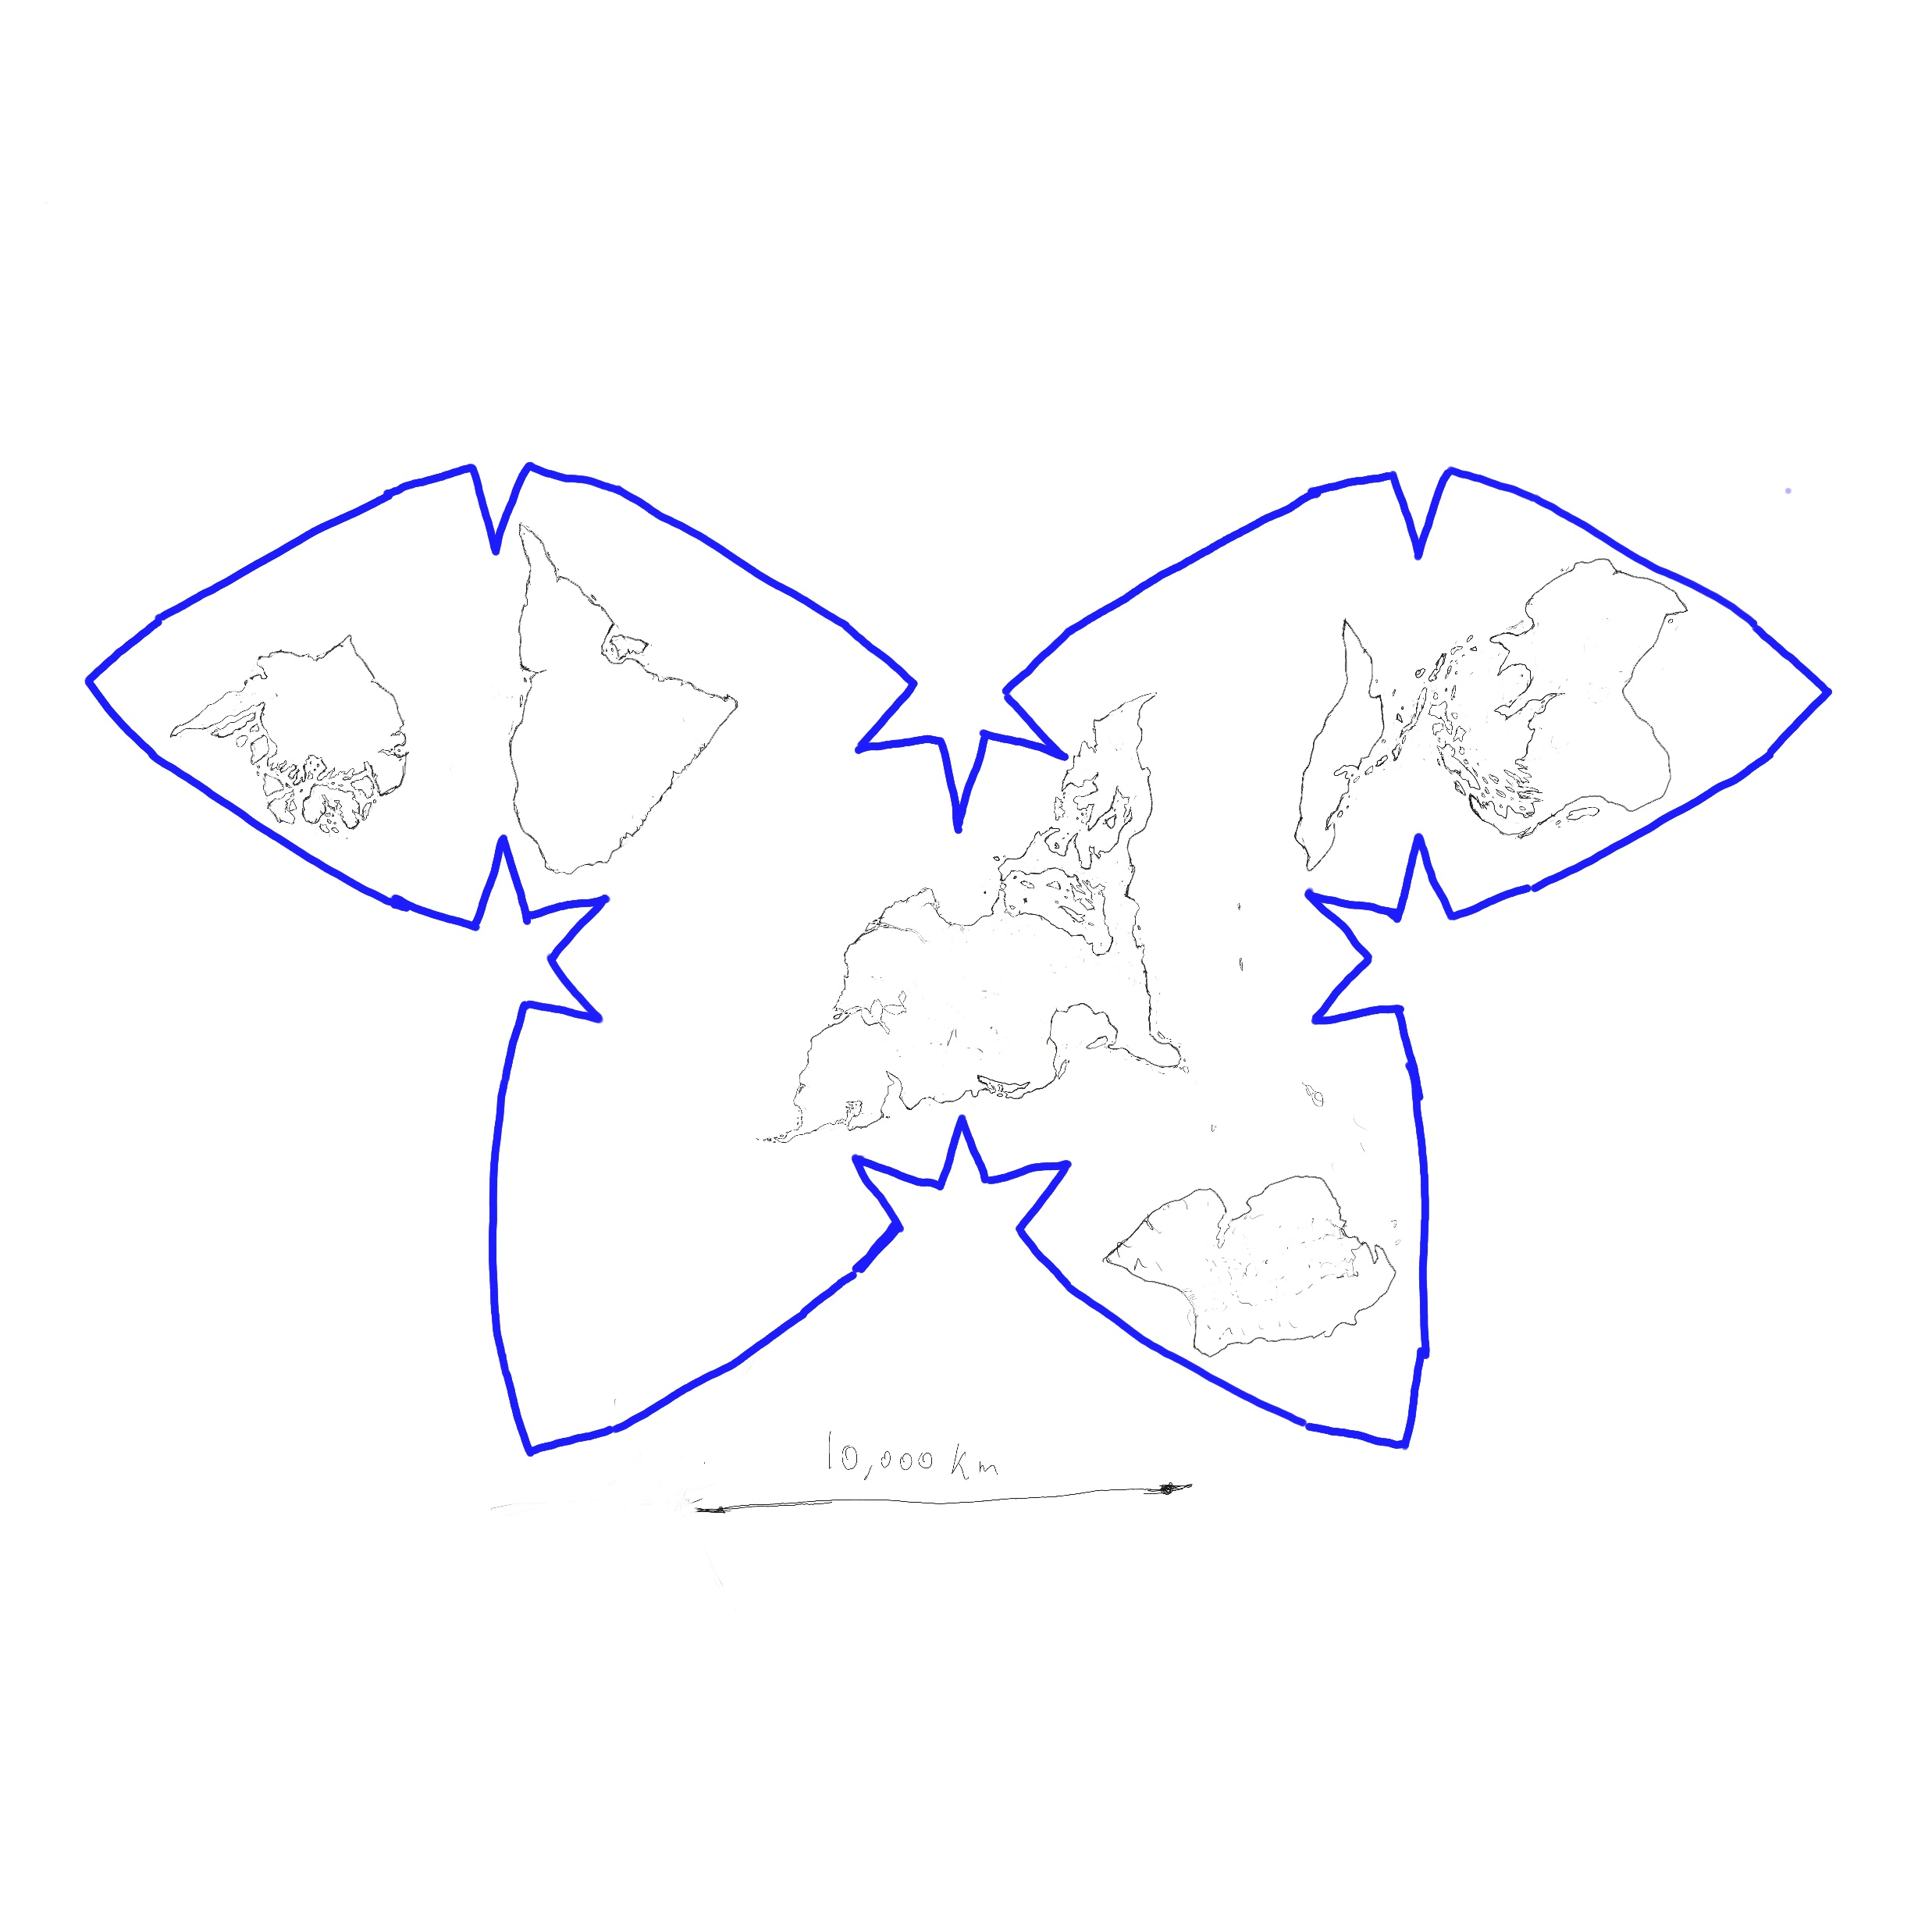
1
2
3b
4
3a
5
6
Circle is the size of France

Slide 5
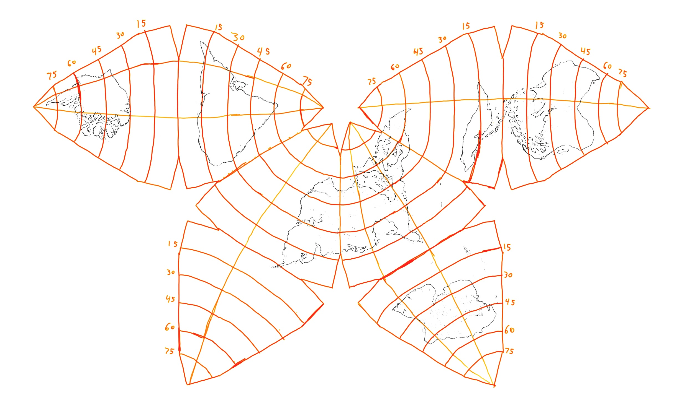

Slide 6
Skies/Times
This planet has rings
30 degrees off rotational axis
A day is 18 hours (Earth Time)
How long does it take for each moon to cycle through its phases?
Big one 27 days (Just under 18 months)
Small one 70 days (About 7 months a year)
Sweep the groove (very tiny) is every 90 minutes (so 12 passes a day)
How many days does a year last?
495 days (equatorial… the poles will have fewer of course)
This gives the planet about the same year length as Earth, but very different months

Slide 7
Celestial Objects
There is one main moon which can cause eclipses, one smaller one maybe ¼ of the other moon size, and since the rings are split, there must be a “moon that swept the groove”
There are 6 visible planets
There are star charts that I drew
Consider where you are on the planet on whether you use North or South Hemisphere drawing, North Left, South Right

Slide 9
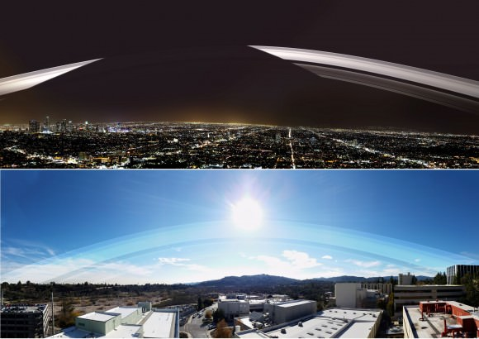

Slide 10
2 Species together
Societies are made of 2 types of people
Demihumans (very similar to humans, but first assignment looks at differences)
Imps (little guys, a lot like cats)
Your society needs to include both

Slide 11
The Unobtainable
At the heart of each continent are places not of the world
Elemental Poles
Pillars of light
Each is said to have a consciousness/force within it
Call unobtainable because things that go in don’t come out
Many things associated with them (elements, colours etc)
Certain phenomena are understood to come from these places
Especially Kaiju, “Monsters”, Imp modifications, Sky Touched, Seedborn
Inspiration: Buddhas, Elemental Dragons from Exalted (gods to a lesser degree, especially creator gods)

Slide 12
Colours of the unobtainable
1 The Onyx (Black)
2 The Alabaster (White)
3 The Azure (blue) and Verdigis (green)(Qing)
4 The Xanthous (Greek for yellow)
5 The Crimson (Deep red)
6 The Amaranthine (purple)
There is a chart to fill out in your writing circle related to this

Slide 13
Demi-Humans
There are no actual humans on this world
Instead, they are near humans: there will be traits that will feel the same but different
Diversity in both cosmetic traits and environment adaptation
They will mostly be human like in biology (omnivores, long lived etc), and can interbreed with each other
Due to presence of “Sky Touched”, strange pigmentation is common
First project focuses in part on these beings

Slide 14
Sky Touched
Demihumans who have obtained a strong affinity and control of one of the Unobtainable
Not present in Imps or animals
This grants power, but changes them
They tend to have skin in a tone of the unobtainable they are associated with

Slide 15
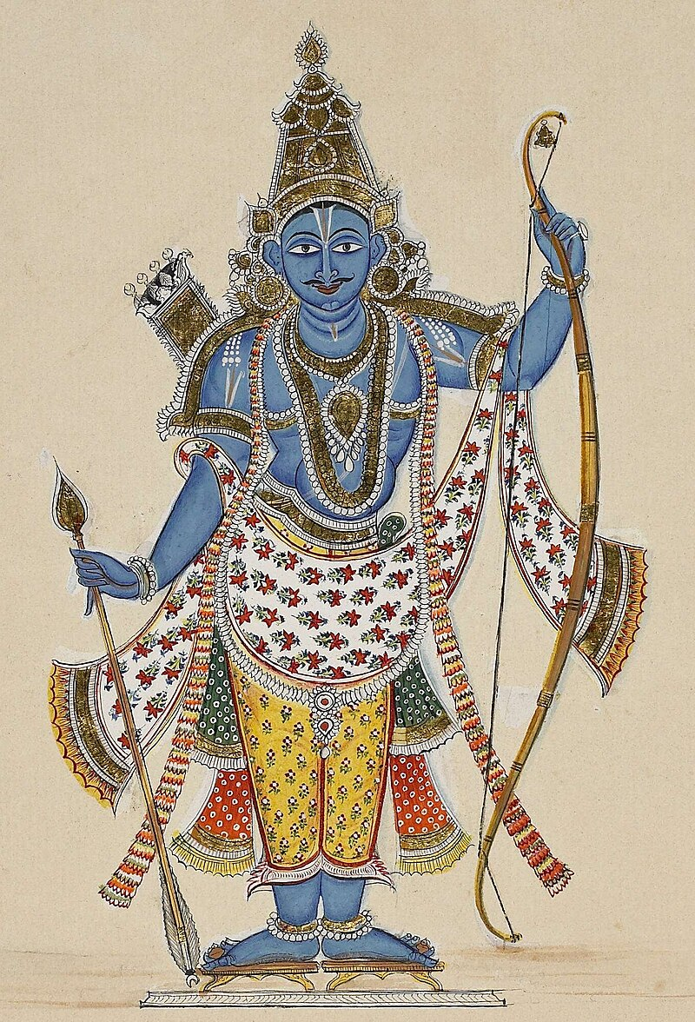
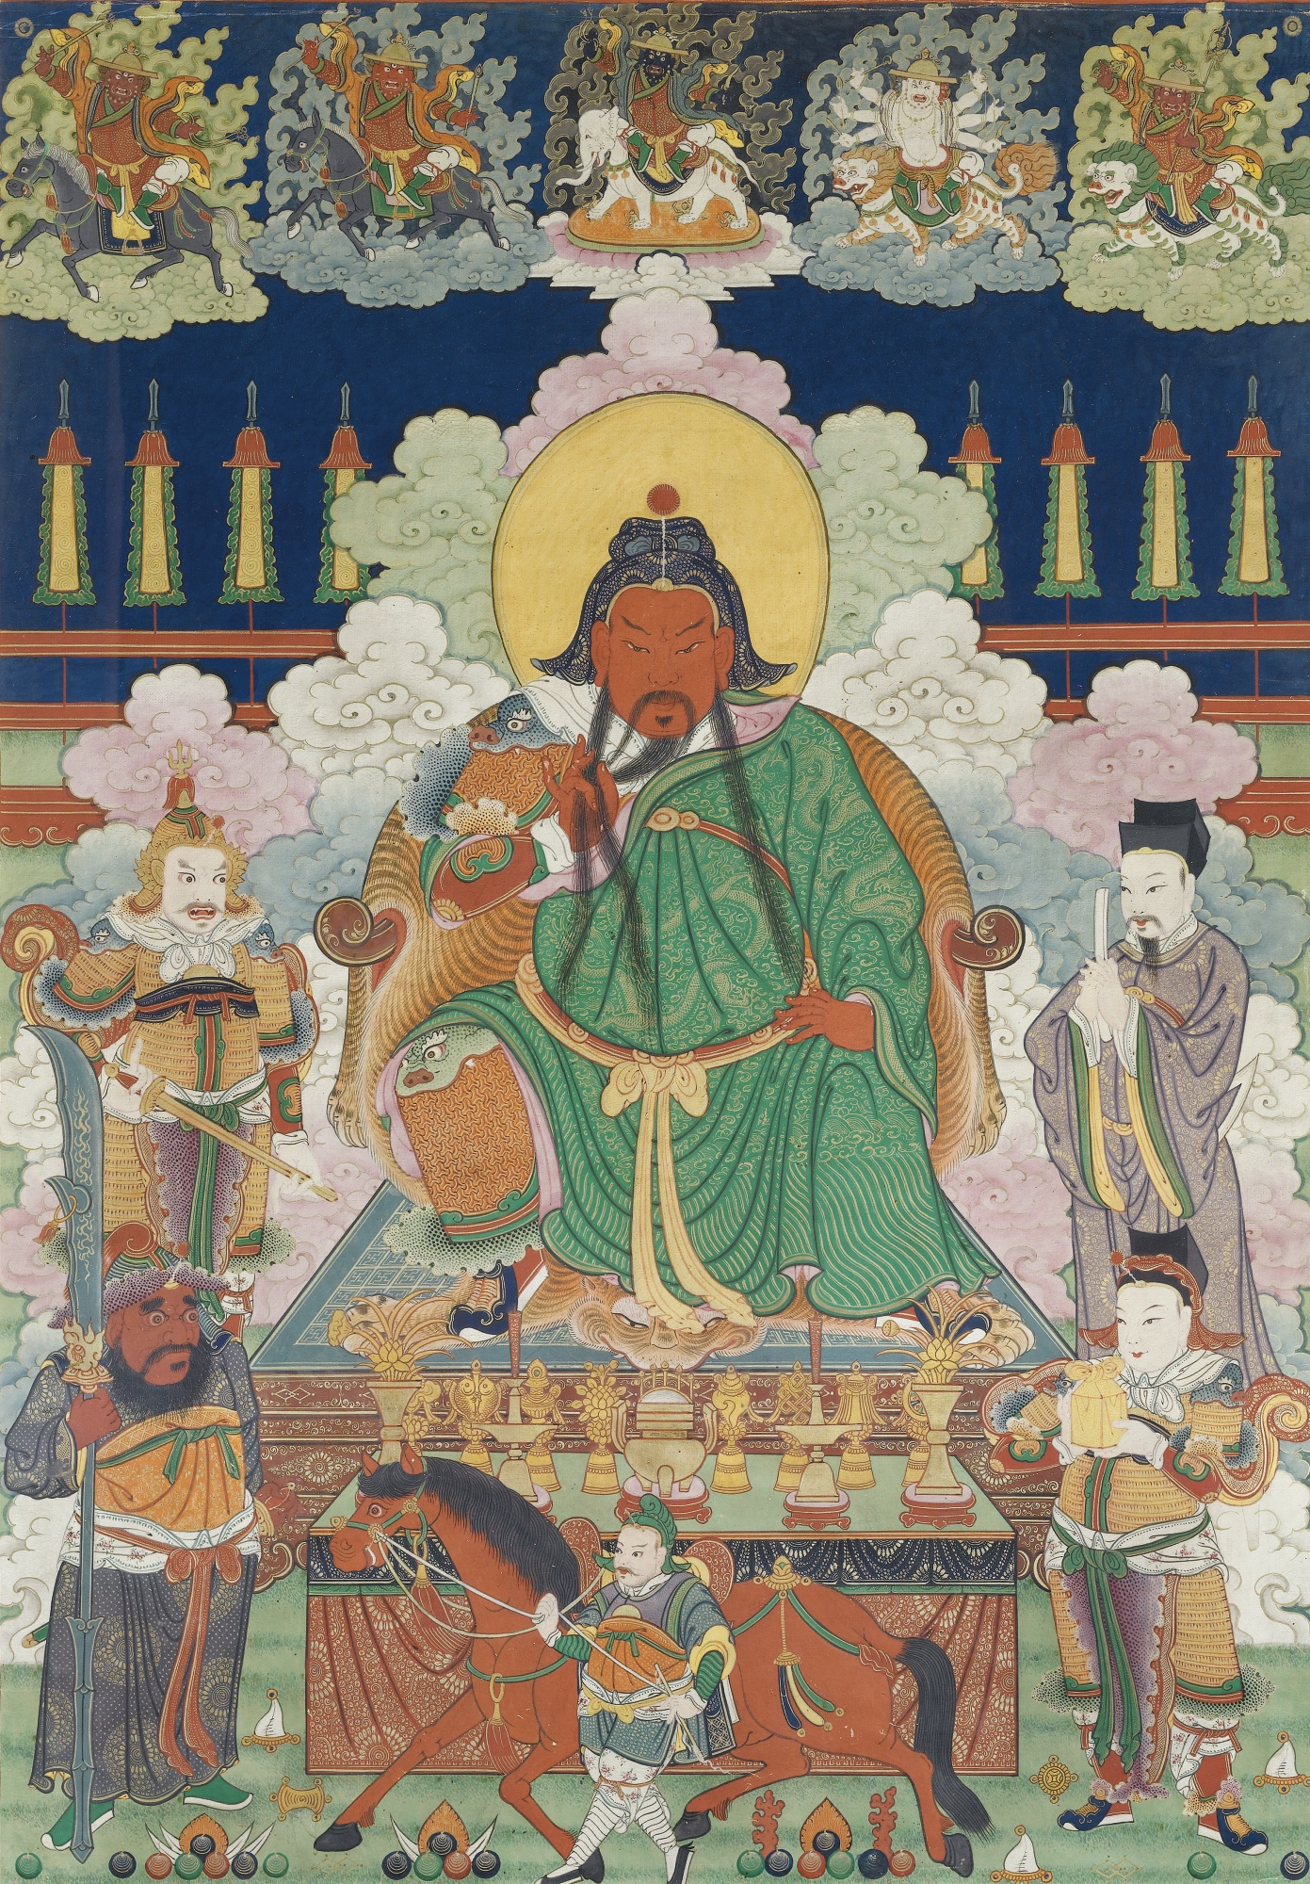
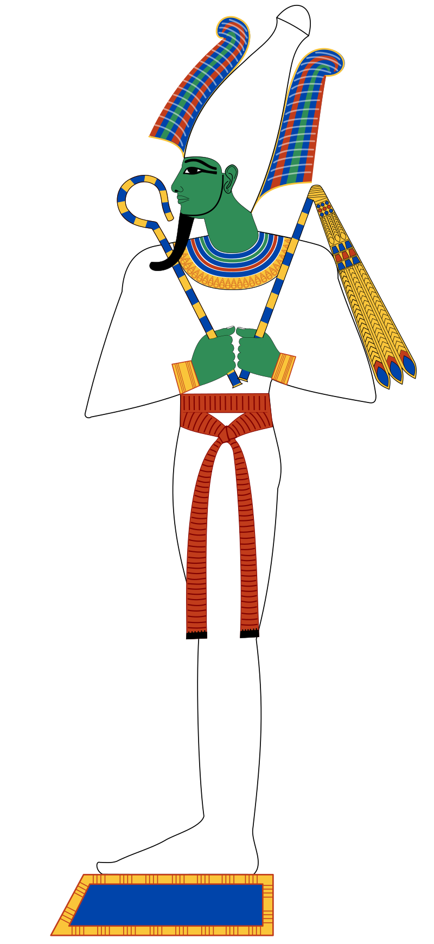
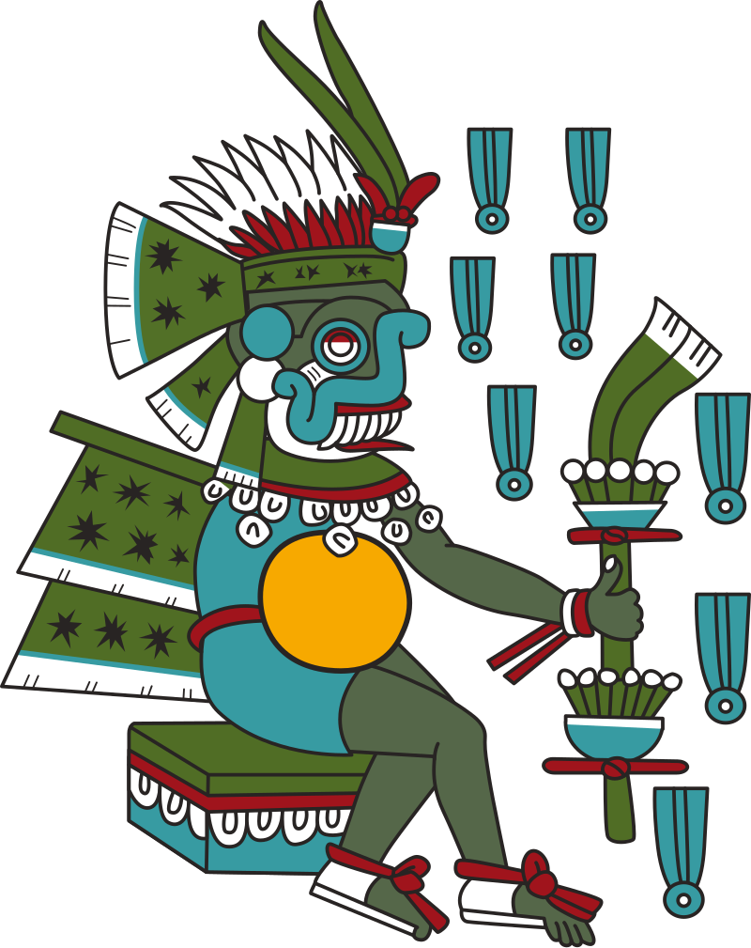

Slide 16
“Imps”
Small animalistic people: adults up to 1.2 m tall (tails would make longer)
There will be a base form provided
Each continent has a specific elemental form associated with the unobtainable/kaiju of the continent
This is sort of like eevee from pokemon
They will be developed in the first project (along with the demihumans)
Related metaphysically to the mountains that walk (which are understood to be the mounts of the unobtainable aka kaiju)
Live in community with the Demihumans: relationships could take many forms
Mandatory to have both demihumans and imps accounted for in your culture: absence of one implies something terrible has happened

Slide 17
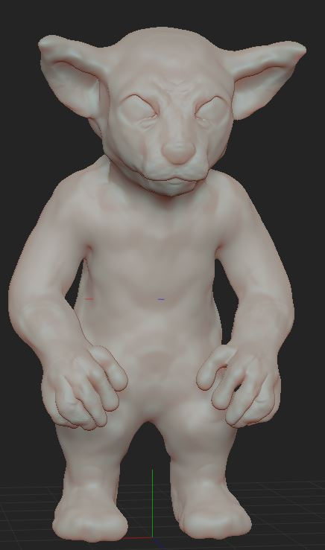
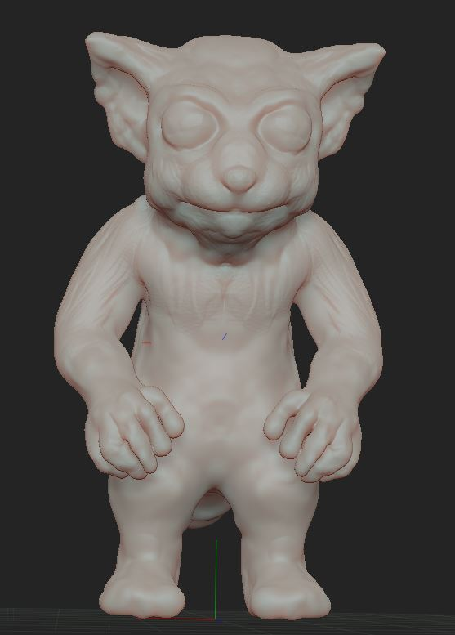
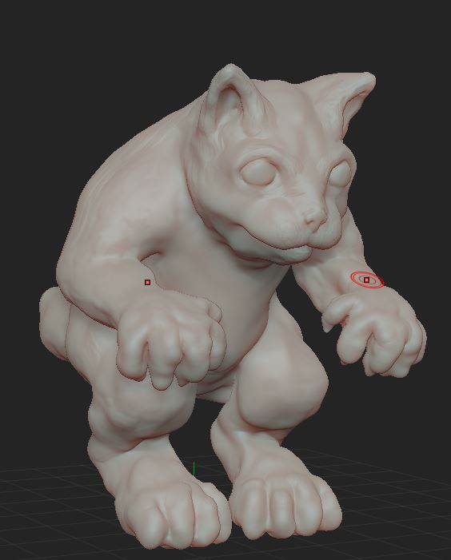
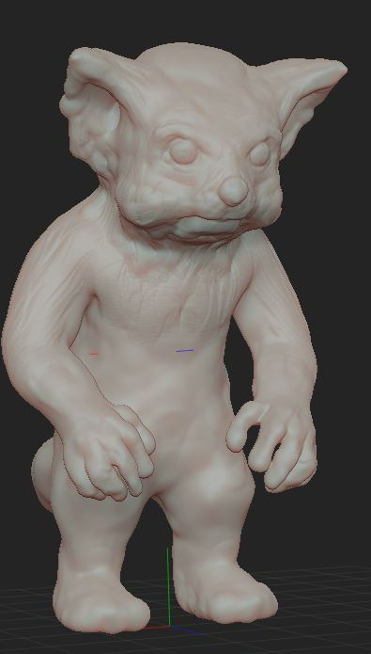
Potential base form of “Imps”
1m

Slide 18
Kaiju (The mountains that move)
Inspiration: Godzilla, monster hunter, gaia theory, rides of gods and buddhas
Every continent has a signature giant creature, measured in tens or even hundreds of meters
Tied to other monsters, Imps
Not biological, but seem biological
Sustained by unobtainable energy
Will arise again if slain
Have seemingly elemental powers

Slide 19
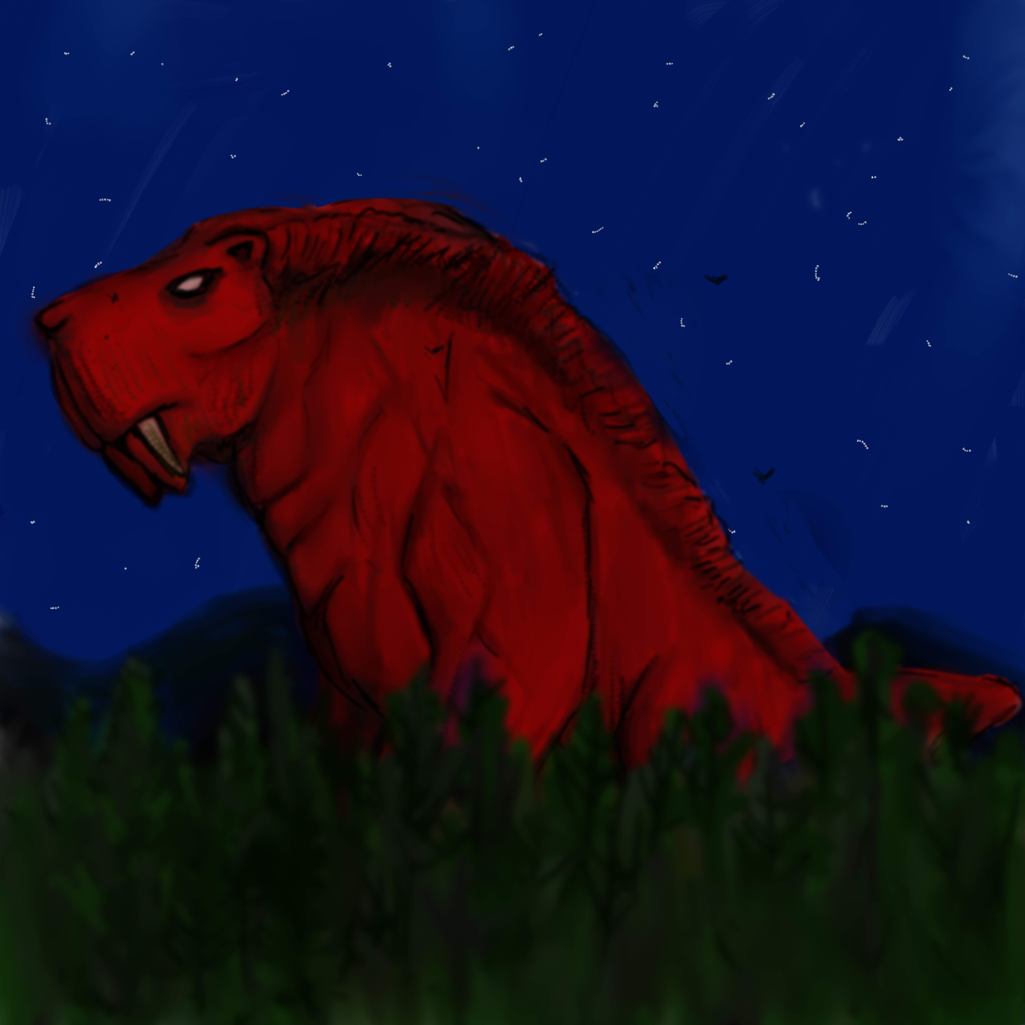
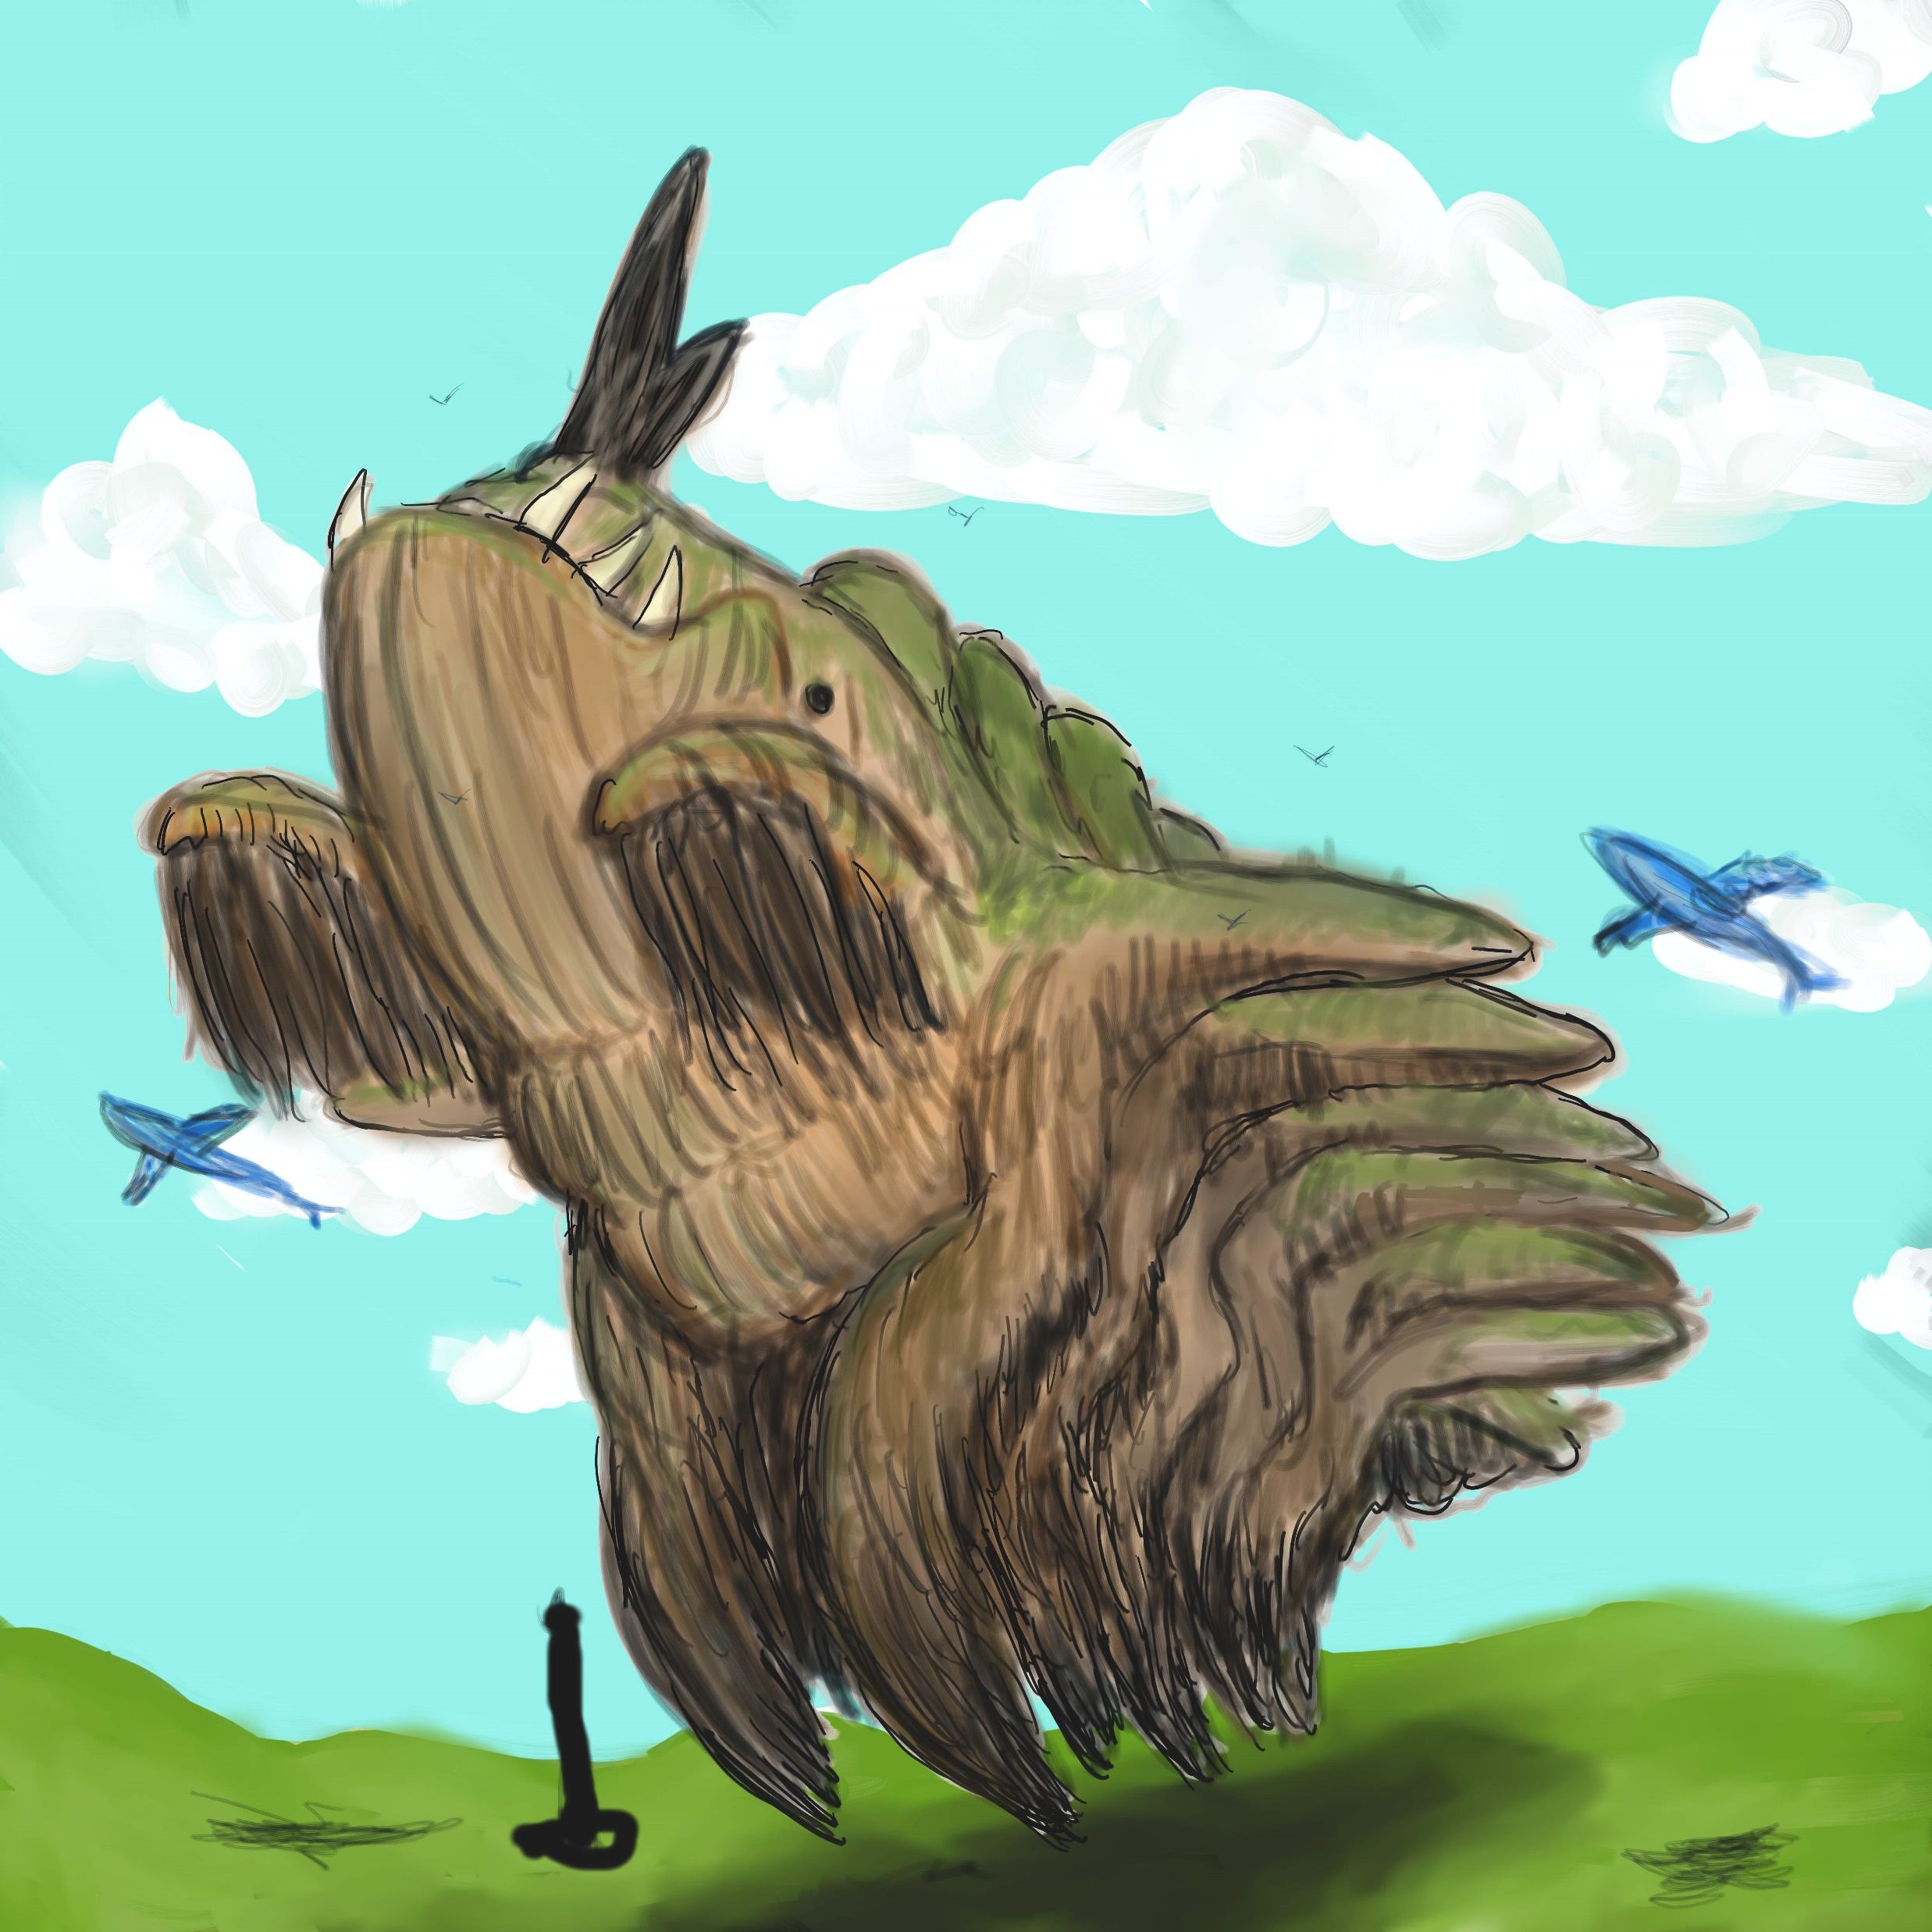
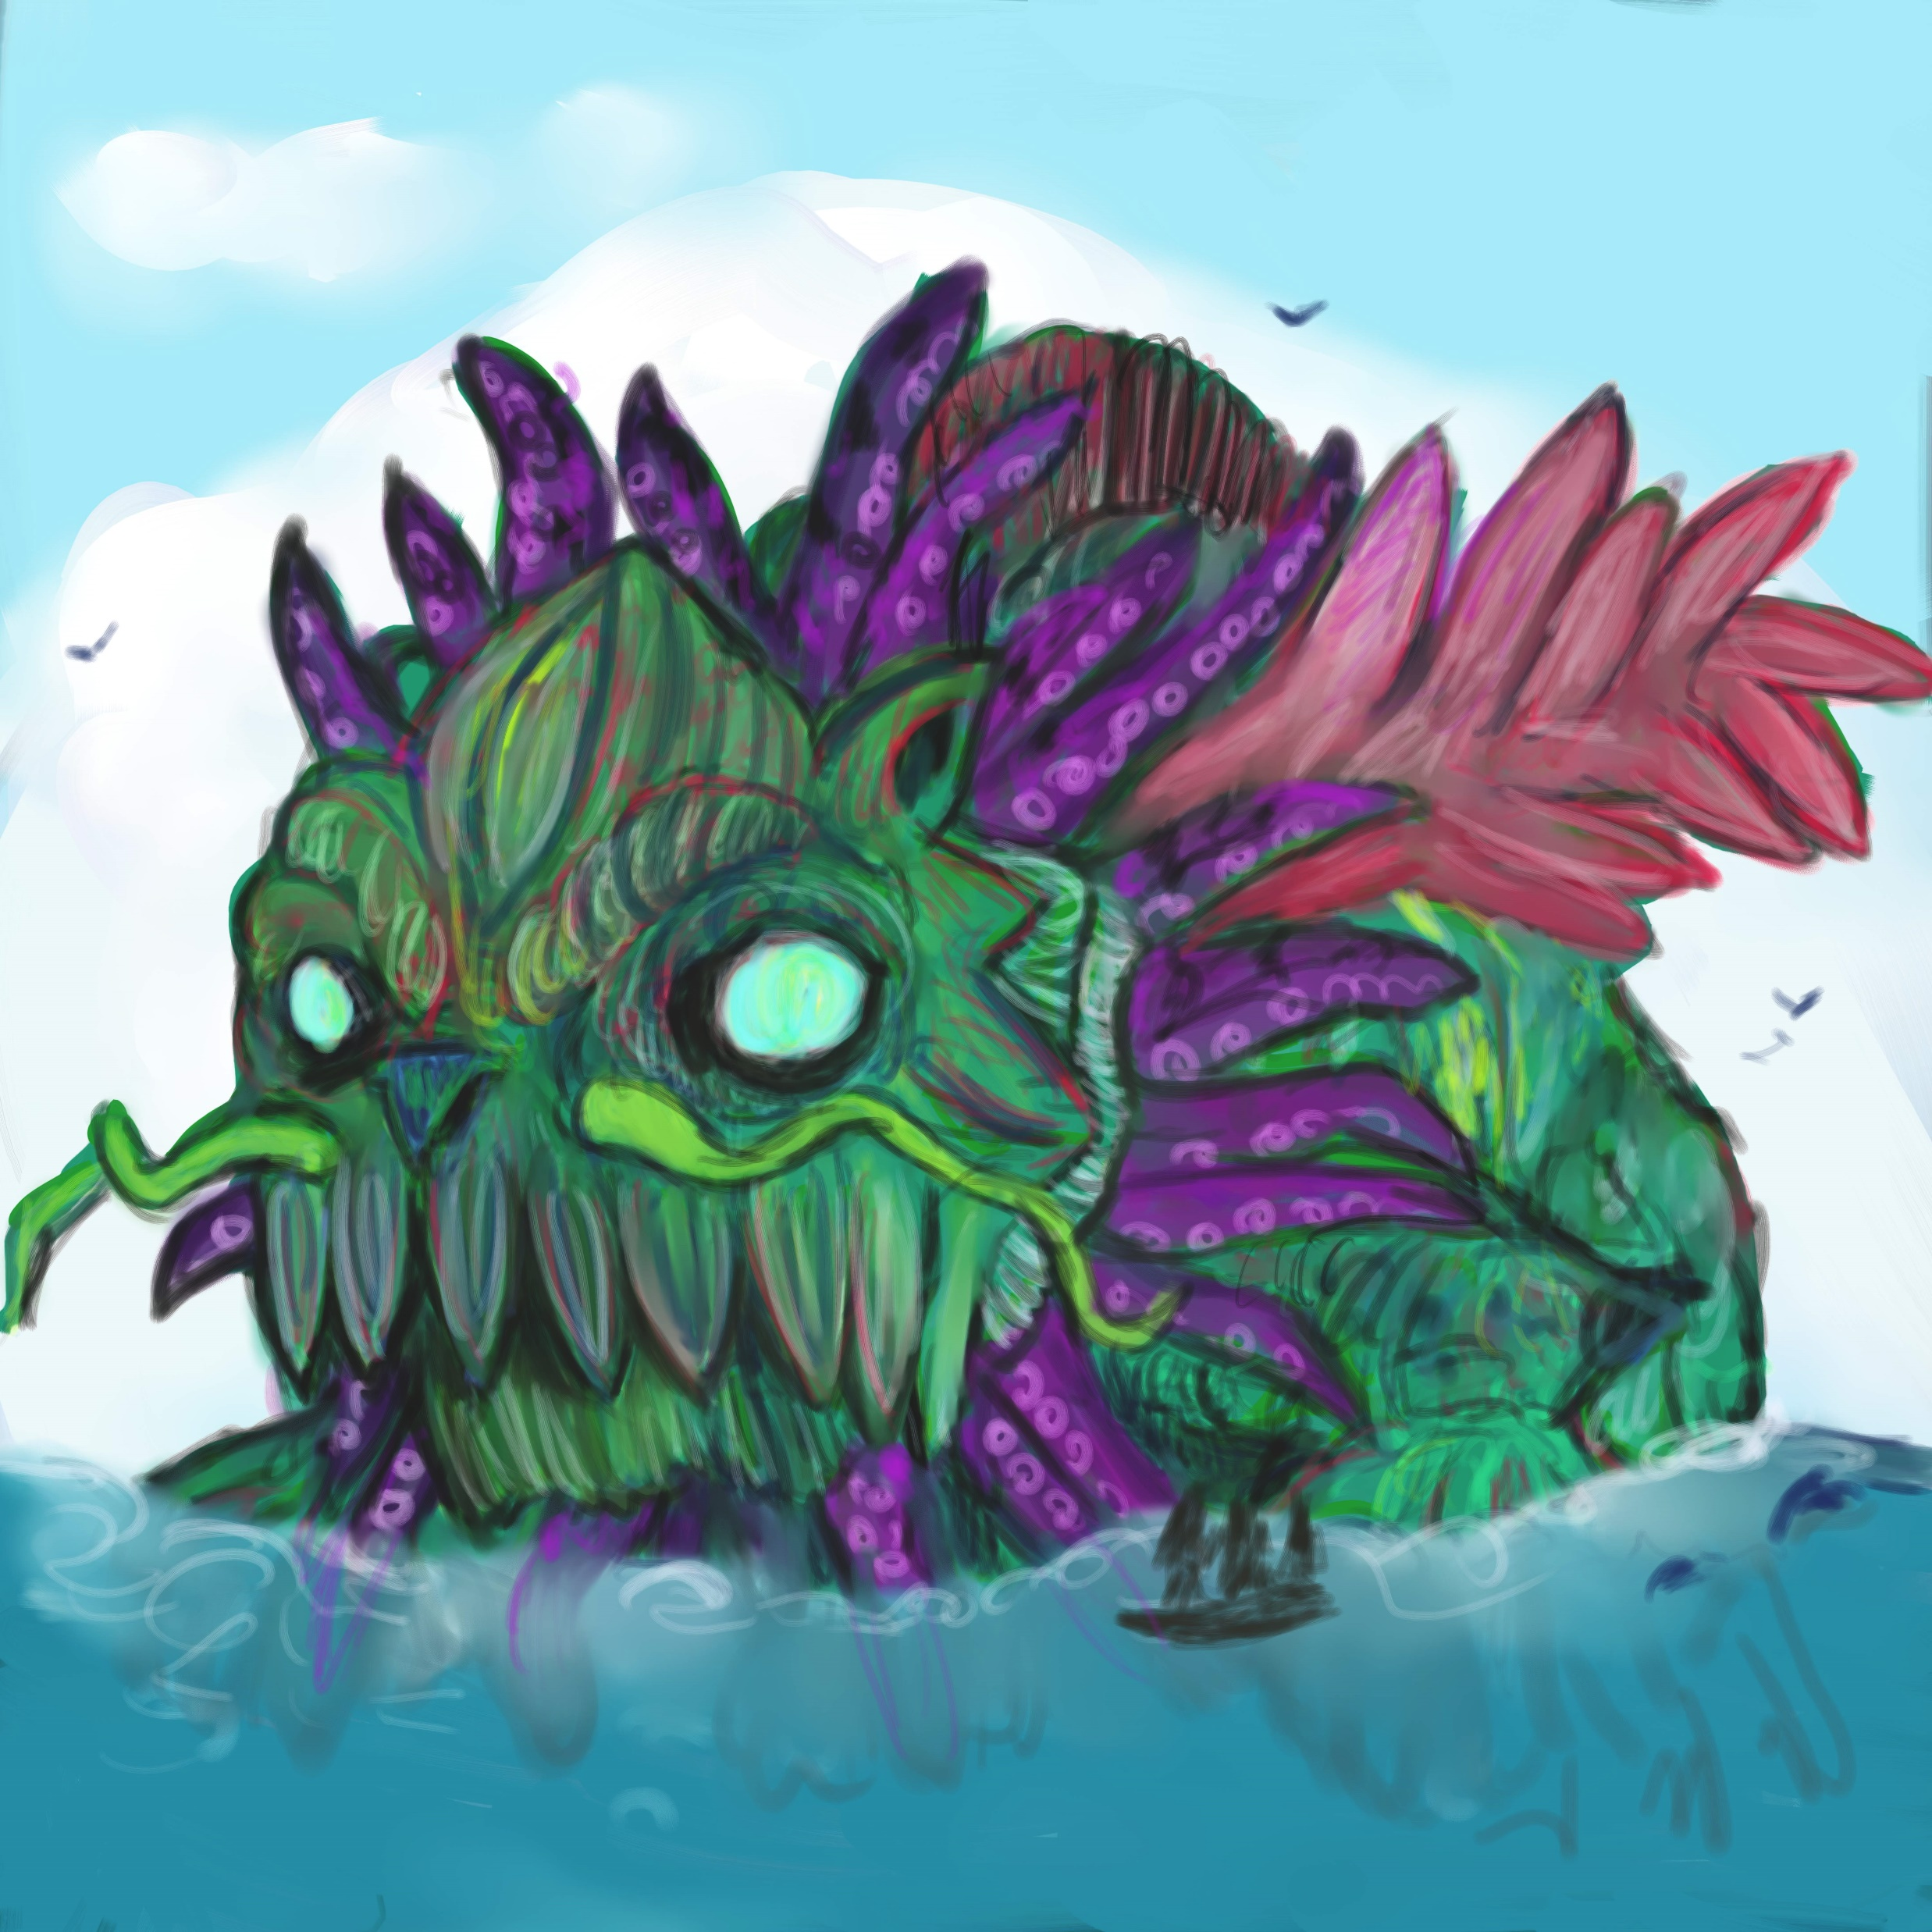
3 of the Kaiju

Slide 20
Seed Born
Non-usual biological entities born from plant sources (giant Flowers/Fruit/Seeds)
Each is associated with a specific unobtainable
Can be called up in rituals (extensive magic theory of incarnating them)
Sometimes just appear
Somewhat anthropomorphic (human parts)
Commonly also have animal parts (see Egyptian gods, angels)
Always clearly inhuman
Some are enhanced versions of dead sky touched?
Unable to fully express will of their unobtainable
Short lived (incarnation on order of months)
Unclear if each incarnation is actually same being
These are meant to be more inhuman gods, angels, daikini, bodhisattvas, demons

Slide 21
Other Supernatural beings
There are 5 other types of beings that manifest in relationship with the Unobtainable

Slide 22
The kings of serpents (Naga)
Highly metamorphic beings, eternal but not immortal
Semi-biological beings: breath, eat, grow but don’t reproduce normally
Many stages in their lifespan (larval stages and the like)
Metamorphosis
Born from normal animal eggs
Decide whether set order or any in the sequence
Some stages seem mostly mundane
Some hybrids, too many body parts etc
Some stages sapient, some less so
Some stages are conduits for wisdom of unobtainable
Every continent has its own type (see map for numbers)

Slide 23
Storm Kings (Garuda)
Semi-Biological beings
Marked birds or pterosaurs
Born and live as normal flying archosaurs until a point in their lives
Fully sapient after transformation
Gain powers of weather modification tied to their unobtainable affinity
Often form flocks of those associated with the same unobtainable

Slide 24
The Children of the Kaiju
Besides the Imps, the kaiju will form unique creatures
These will be made of things within its affinities
These are semi-biological at best
(This is an excuse for other, more natural monsters)

Slide 25
Pretas
Beings that are destructive to a specific unobtainable
Born to demihumans
Sort of anti-skytouched
If they reproduce, their children will be normal (within bounds)
“Vampires”, often born in areas of excess unobtainable energy
Painful existence of becoming a bit of a scapegoat
Need to absorb things associated with their lacking unobtainable
Organs/fluids associated with an unobtainable common

Slide 26
Things from the Rings (Horrors/demons)
Rings are mostly like other planetary rings: ice, bits of rock, dust
Greater and lesser rings recognized
Chunks of the rings will often fall, especially near to the equator
Some of the chunks have eldritch horror type things frozen in them, things of weird elemental combinations, too many limbs, not biological, often like pretas writ large

Slide 27
Remnants (magic places and items that intrude into the world)
There are structures and anomalies that exist in the world, likely from the unobtaibale: spontaneously come into existence
React to those touched by the unobtainable
“dungeons”, god-machines/engines, magical artifacts, terma
Sanctuary trees: specific large trees that have resonance with the unobtainable, associated with seedborn

Slide 28
The Masses
Floating, living islands
Part mangrove, part coral reef, part Portugese Man o’ War
(Floating island stories are cool)
These islands that float are somewhat common, especially in the sea between the 2 parts of continent 3

Slide 29
Alternative Paths (Detailed a bit in technology and biology)
Besides the changes presented above, much of the world is meant to be very similar to earth
Resonance of Earth biota, technologies provides common language
Expectation to explore alternate evolution of biology (and probably culture including technology) part of later units
This is mundane convergence/divergence, not meant to be supernatural like above (but could be in reaction to more supernatural situations)

Slide 30
Unobtainable energy flow: Dharma engines
Unobtainable poles and beings produce energy flows of these energies
Objects can interact with these energy flows: sigils, materials needed
Spinning versions of the objects commonly made, like Tibetan Buddhist Prayer wheels
Prayer wheels to enhance or channel these energies possible
Compasses related to sensing these energy flows common navigation and tracking aides
Dharma engines: wheel marked with sigils and minerals that will spin freely without input under this energy
Energy varies extensively, so wheels need to be calibrated
Many stationary
Mobile ones might be a collection of them with extensive skill to use
Sky touched, kaiju, seedborn mess with general calibration: some calibrated to these beings
May or may not have weird resonance with electricity and magnetism
Mostly these limitations are to encourage other power sources at times as well

